Slide 1
kz' ;]jf zfvfsf] cf=j=)&(÷*) sf] cw{ aflif{s k|ult ;ldIff
K|f:t't stf{
kz' ;]jf zfvf, t'n;Lk'/

Slide 2
cf=j= @)&(÷)*) sf] kz' ;]jf zfvf tkm{sf] l:js[t aflif{s sfo{qmd =======

Slide 3
cf=j= @)&(÷)*) sf] kz' ;]jf zfvf tkm{sf] l:js[t aflif{s sfo{qmd =====

Slide 4
lalgof]hLt ah]6 tyf vr{ k|ltzt
lalgof]hLt ah]6 M $%)))))
xfn;DDsf] e'Stflg /sd M !^$@(&*
ljQLo k|utL M #^=% Ü

Slide 5
Zffvfaf6 nIo cg';f/ ;DkGg ePsf lqmofsnfkx? M
E]f6]l/g/L cf}iflwx? vl/b ul/ cTofj:os cf}iflwx?sf] k|of]u ul/ l8:k]G;/L Pj+ k|of]uzfnf ;]jf ;+rfng ub]{ cfPsf] .
s[ifsx? ;+u kz' :jf:Yo sdL{sf] e]63f6 -8f]/ 6' 8f]/ _ sfo{qmd dfkm{t $% eGbf a9L Jofj;flos afv|f kmfd{ lelh6 ul/ sl/a ()) kz'x?sf] :Jff:Yo hfr Pj+ k/fd;{ ;]jfsf ;fy} gfDn] df6] tyf afx\o k/lhlj lj?4sf] cf}iflw ljt/0f, k|hgg ;DalGw ;d:ofsf] klxrfg tyf pkrf/ sfo{ ;DkGg ul/of] .
/]lah /f]u lgoGq0fsf lgDtL ljZj /]ljh /f]u lgoGq0f ;Ktfx ;DkGg ul/ o; zfvfaf6 aif]{el/ lgz'Ns /]ljh /f]u lj?4sf] vf]ksf] Joj:yf ldnfOPsf] 5 .
s[=u=sf] nfuL cfj:os t/n gfO6«f]hg tyf l;d]gsf] vl/b tyf 9'jflg ul/ ;xh ?kdf pknAw u/fpb} cfPsf] .

Slide 6
Zffvfaf6 nIo cg';f/ ;DkGg ePsf lqmofsnfkx? ====
/f]u lgoGq0fsf] nfuL kz'kGIfLdf vf]k sfo{qmd ;+rngd} /x]sf] .
t'=p=d=gkf= j8f g+ $ vfb|]df kz' kG5L :jf:Yo lzlj/ ;+rfng e} ;s]sf] .
kz'kGIfL tYofÍ ;+sng tyf cTofjlws ug]{ sfd rln/x]sf] .
Zfvfsf] nfuL cfj:os kg]{ kmlg{r/sf] vl/b sfo{ ;DkGg e} ;s]sf] .

Slide 7
kz" kl%+sf] ;+VofTds ca:yf
a:t"sf] laa/)f | cg"dflgt ;+Vof | s}lkmot
ufO{ -Sof^n_ | 16 b]lv 18 xhf/ | 550 pGgt Pj+ a)F{ ;+s/ gZn /x]sf] .
e};L -akm_ | 8 b]lv 9 xhf/ | pNn]vlgo ;+Vofdf a)F{ ;+s/ gZnsf] lasf; ePsf] .
e]*F afv|f -Sofk|fOg_ | 45 b]lv 50 xhf/ | e]*fdf :yflgo gZn / afv|fdf a)F{ ;+s/ lasf; qmddf .
;"u"/ a+u"/ -;"cd_ | 6 b]lv 7 xhf/ | pGgt gZnsf] afx"Notf /x]sf] .
k+l% -PlePg_ | 6 nfv 50 xhf/ | n]o;{, a|f]On/, a|f]On/ Kof/]G^ / :yflg -nf]sn_ gZnsf s"v"/f xf¤; clg ^ls{ cflb

Slide 8
kz" hGo pTkfbg
qm=;+= | pTkfbg | dfqf | s}lkmot
1 | b"w | 8,000 ln÷lbg
2 | c)*F | 70,000 uf]^f÷lbg | sf]le* kZrft kmfdL{édf sld cfPsf]
3 | df;" | 6,000 s]=lh÷lbg -a|f]On/®4,000s]=lh=,/fuf] e};L 1,200 s]=lh=,vl; afv|F®500 s]=lh=/ kf]s{ 300_

Slide 9
s[ltd uef{wfg
सि.नं. | क्रियाकलाप | इकाई | k|=rf}=k|ult | hDdf k|ult | कैफियत
1 | गाई | संख्या | 215 | 236
2 | भैसी | संख्या | 90 | 97
3 | Affv|f | संख्या | 0 | 0
 | s’n hDdf |  | 315 | 333

Slide 10
पशु स्वास्थ्य सेवा
सि.नं. | क्रियाकलाप | इकाई | cw{ aflif{s k|ult | कैफियत
1 | उपचार सेवा | संख्या
1=1 | pkrf/ | ,, | 825
1=2 | dfOg/ ;lh{sn | ,, | 330
1=3 | ufO{gfSnf]lhsn | ,, | 145
1=4 | k/lhla lgoGq)f | ,, | 6374
hDdf ;+Vof |  |  | 7674

Slide 11
पशु स्वास्थ्य सेवा
सि.नं. | क्रियाकलाप | इकाई | cw{ aflif{s k|ult | hDdf k|ult | कैफियत
2 | kz‘ vf]k ;]jf | संख्या
2=1 | P=cf/=le= | ,, | 344 | 344
2=2 | l*=Pr=lk=lk=Pn | ,, | 12 | 12
2=3 | sf]/f]gf | ,, | 15 | 15
2=4 | Pkm=Pd=l* | ,, | ,,
2=5 | Pr=P;=la=So” | ,, | ,,
2=6 | :jfOGf lkma/ | ,, | ,,
2=7 | lk=lk=cf/= | ,, | ,,
2=8 | l^^fg; ^S;f]O* | ,, | ,,
hDdf

Slide 12
पशु स्वास्थ्य सेवा
सि.नं. | क्रियाकलाप | इकाई | cw{ aflif{s k|ult | hDdf k|ult | कैफियत
3 | k|of]uzfnf ;]jf | संख्या
3=1 | gd’gf hfr -uf]a/_ | ,, | 212 | 212 | k/lhla klxrfg
3=2 | za kl/If)F -s’v’/f_ | ,, | 172 | 172 | /f]u klxrfg
4 | kz’ aGWos/)f ;]jf |  | 380 | 380

Slide 13
k|fKt pknAwL
/f]usf] lgbfg tyf pkrf/ .
s[ifsx?n] zfvfsf] l8:k]G;/Laf6 lgz'Ns pkrf/ kfO/fv]sf] .
kz' d[To" b/ sd ePsf] Pj+ e]6]l/g/L ;]jf a9\b} uPsf] .
cfw'lgs kz' kfng ;DaGwL r]tgfdf a[4L .
c08f Pj+ df;' pTkfbgdf cfTdlge{/ /x]sf] .
:j:y kz' / :j:y kz' hGo pTkfbg tkm{ s[ifssf] Aoaxf/df kl/at{ .
kz' gZn ;'wf/ tkm{ s[ifssf] Aoaxf/df kl/a{tg .

Slide 14
;+efjgf
gZn ;'wf/ dfkm{t kz'hGo pTkfbg a9fO{ cfTdlge{/ aGg ;lsg] .
kz' kfngnfO{ ks]6 If]qsf] ?kdf ljsf; ug]{ ;lsg] .
gd'gf s[ifs tyf :yflgo ;|f]t JolQx? kl/rfng ug{ ;lsof] eg] pTkfbgnfO{ a9jf ug{ ;lsg] .
cu'jf s[ifs Pj+ gd"gf kmd{ :yfkgf dfkm{t Aoa;foLs kz' kfng sf] lasf; ug{ ;lsg] .

Slide 15
r'gf}tLx?
b'Uw ;+sng s]Gb|sf] sld .
gZn ;'wf/sf nfuL s[ltd uef{wf/0f ;]jf ;a{ ;'ne x'g g;Sg' .
kz' kfngsf] If]qnfO{ ;+dflgt k]zfsf] ?kdf ;dfhdf :yflkt ug]{ .
kz' wg ;+/If0fsf nfuL ladf ;xh gx'g' .
bfgfdf k|of]u ug]{ sRrf kbfy{ aflx/af6 cfofltt x'g]x'bf bfgfsf] dx+uL tyf pTkfbg nfutdf dx+uL ePsf] .
s[ifsx?sf] pTkfbgdf ;d{yg d'No gx'bf kz'kfng Joj;fo gfkmfd'ns x'g g;Sg' .

Slide 16
;d:ofx?
!= zfvfsf] cfkmg} eag gx'bf cfw'lgs k|sf/sf] ;]jf lj:tf/ ug{ g;lsosf] .

Slide 17
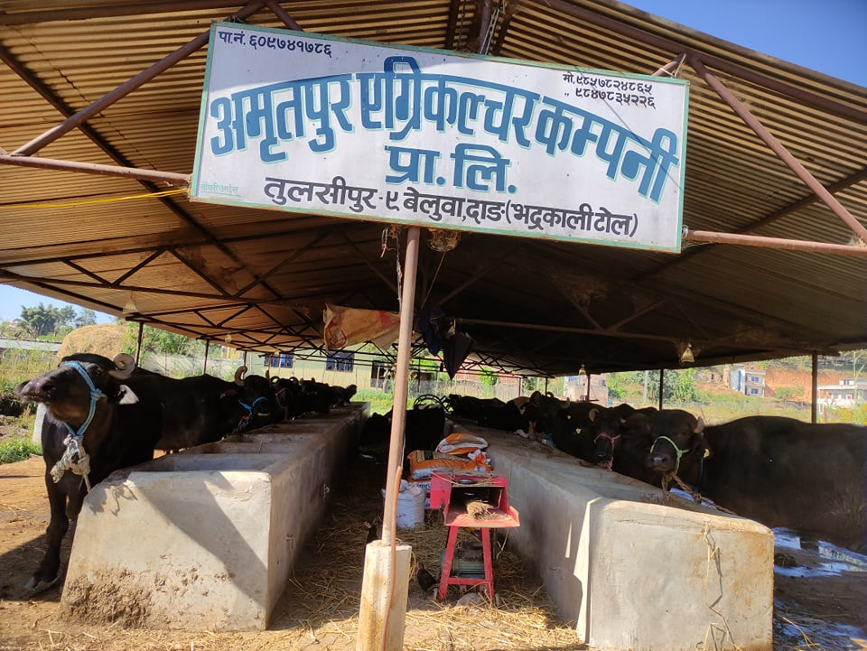
s]lx kmf]6f]x? M

Slide 18
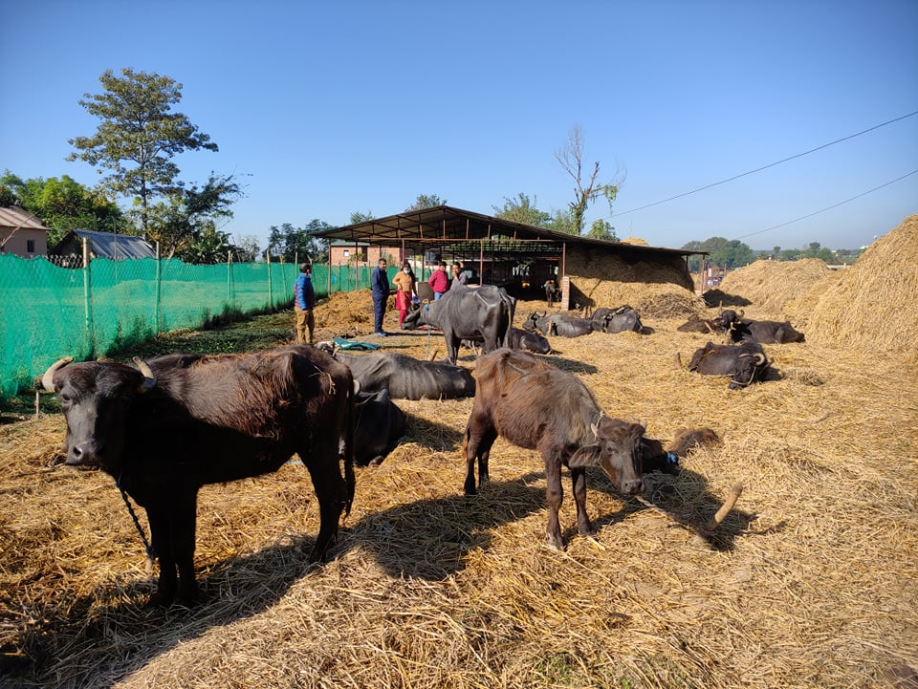
s]lx kmf]6f]x? ====

Slide 19
wGoafb Û
ho kz"wg

